Slide 1
Online Asbestos Notification Revision Submittal
Compliance

Slide 2
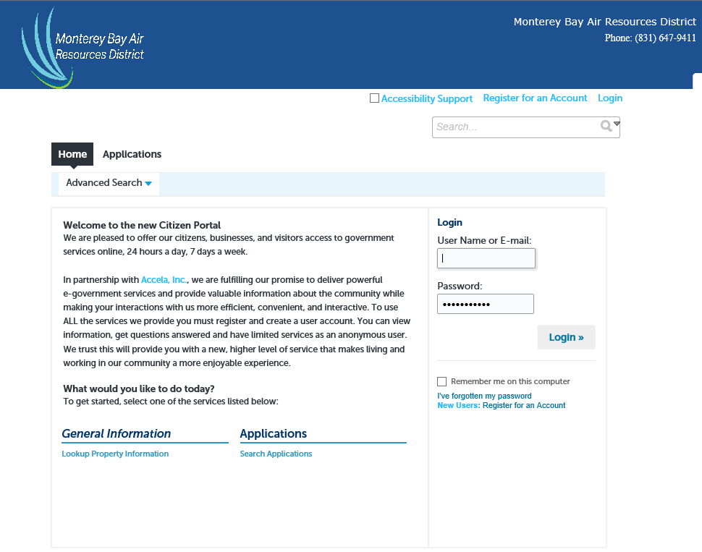
Log on to Account

Slide 3
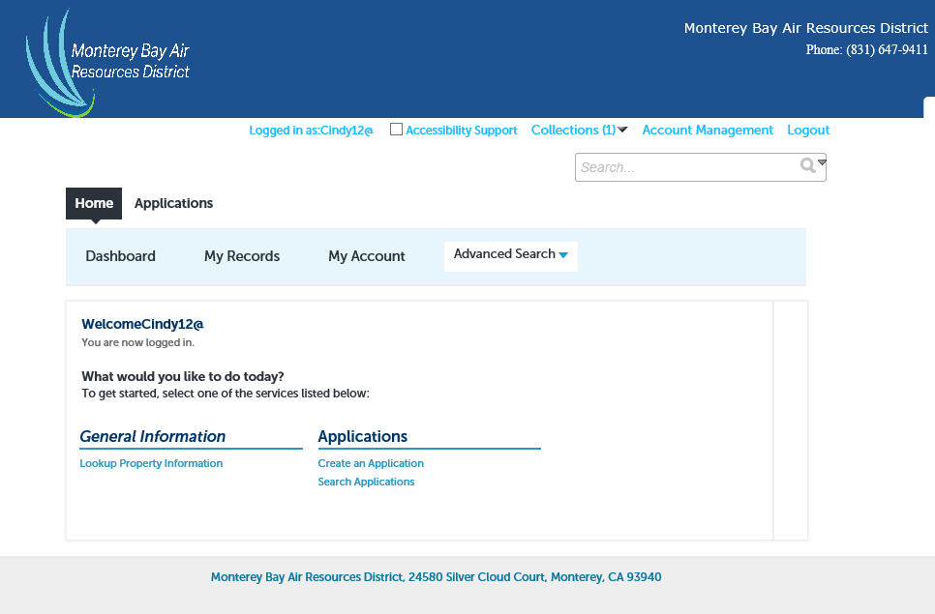
Retrieving Notifications
Click on My Records

Slide 4
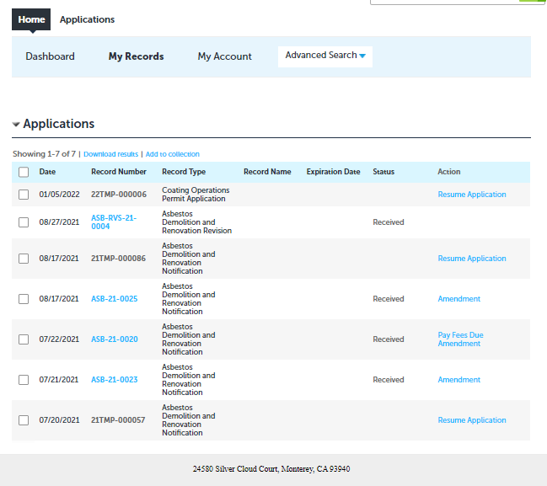
Retrieving Records
Choose the Record you wish to revise and click on “Amendment”

Slide 5
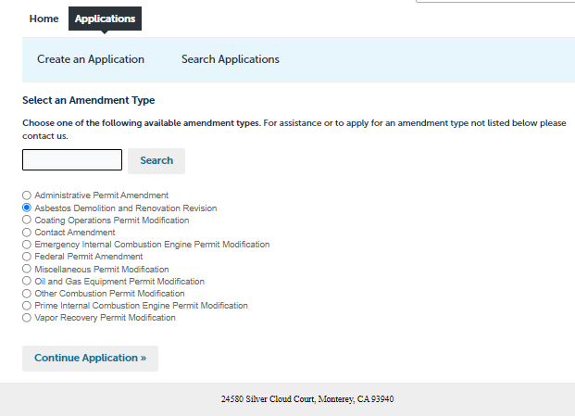
Choose “Amendment Type”
Choose Demolition and Renovation Revision

Slide 6
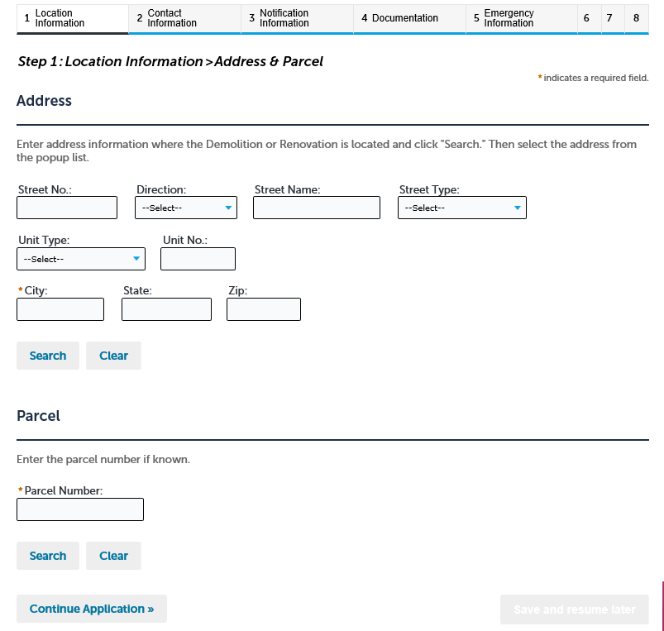
Begin Revision
Both address and parcel should be already completed from the original notice. Click on continue Application at bottom of page.

Slide 7
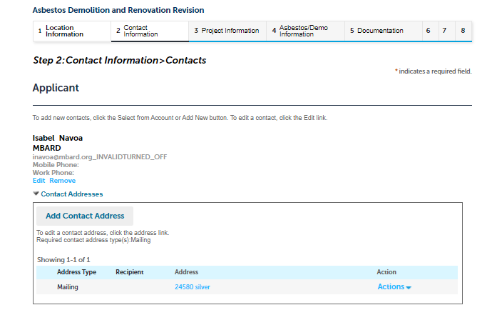
Review Contact Information
No changes needed to contacts. Click on continue Application at bottom of page.

Slide 8
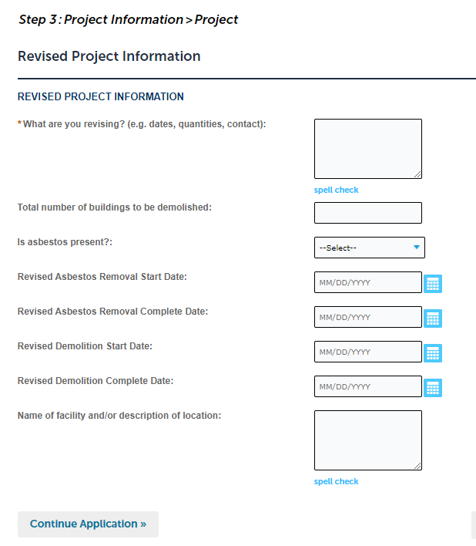
Revised Project Information
Make any revisions at this step.
Complete all fields related to the revision.
Next page is for RACM changes.

Slide 9
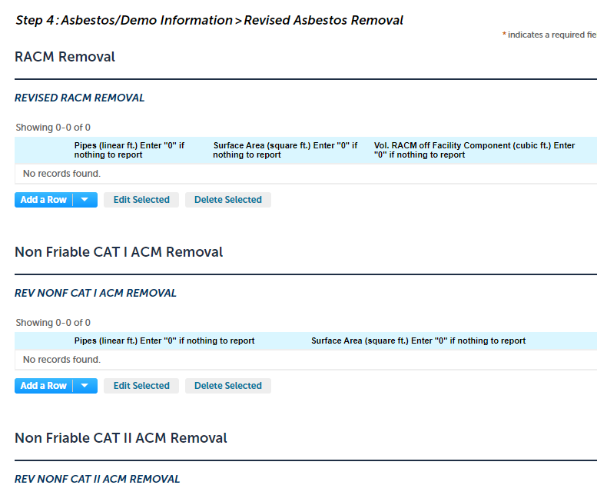
Revised Asbestos Information

Slide 10
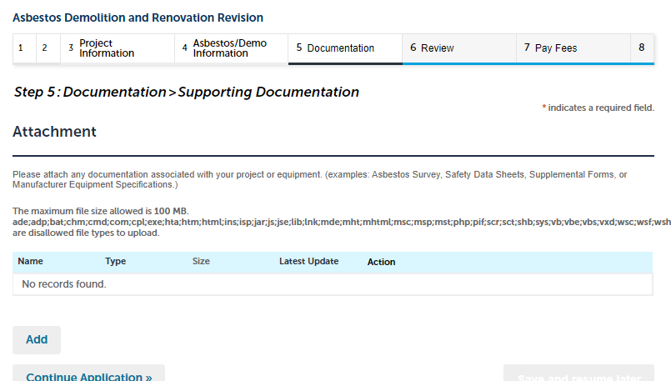
Add Documents, applicable

Slide 11
Review Revision

Slide 12
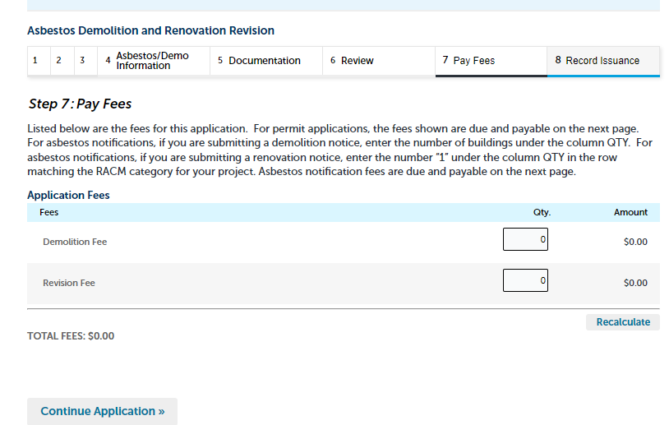
PAY FEES
Bypass if no changes to quantities or buildings. Click on Continue Application

Slide 13
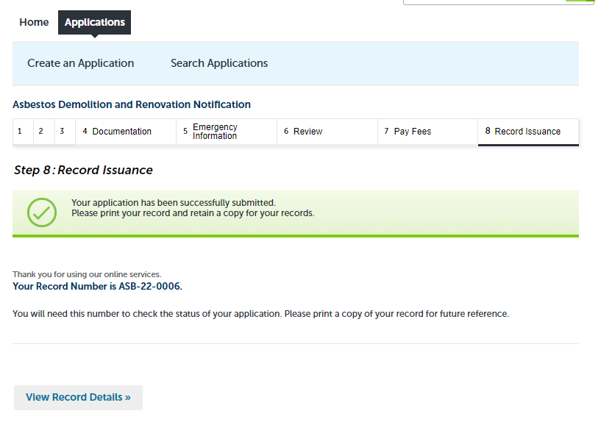
Revision Record Issuance

