Slide 1
Monterey Bay Air Resources District Diesel Engine & Equipment Replacement Grant Program
Application Workshop
January 12, 2021

Slide 2
What is the Carl Moyer Program?
“provides grant funding to encourage the voluntary purchase of cleaner-than-required engines, equipment, and emission reductions technologies.”
- CMP Guidelines
Complements regulations to obtain early or
extra emissions reductions

Slide 3
Other Funding Sources
Funding Agricultural Replacement Measures for Emission Reductions (FARMER) Program
Provides funding for agricultural harvesting equipment, heavy-duty trucks, ag pump engines, tractors, and other equipment used in ag operations
Community Air Protection Program (CAPP)
Focus is to reduce exposure in communities most impacted by air pollution.

Slide 4
Workshop Purpose/Outline
Purpose
Increase chances of a project’s success by encouraging the completion of thorough and accurate applications
Outline
Identify Project Types
Project Eligibility
Application Requirements
Project Evaluations

Slide 5
Project Types
Agricultural Irrigation Pumps
Marine Vessels
Off-Road Equipment Replacement
On-Road Electrification & EV Infrastructure

Slide 6
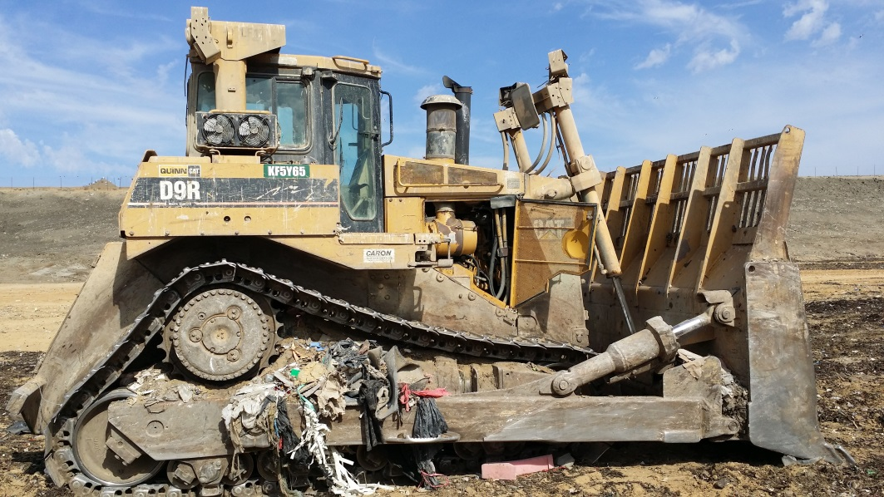

Slide 7
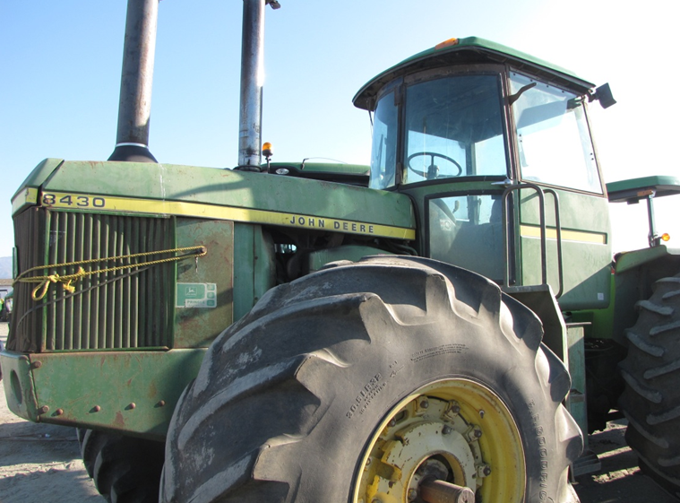

Slide 8
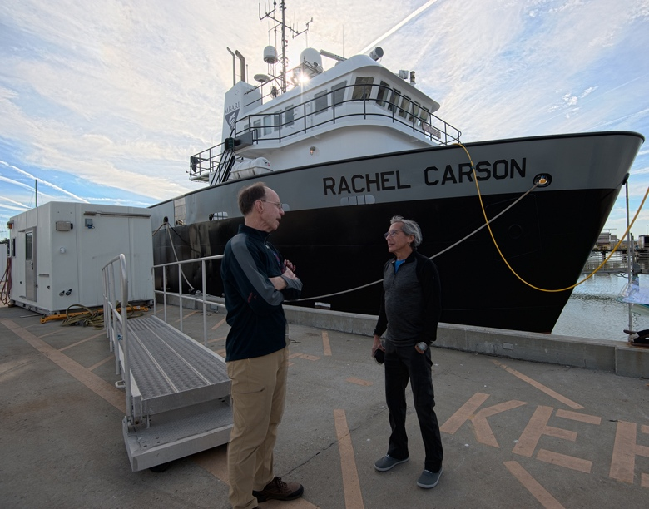
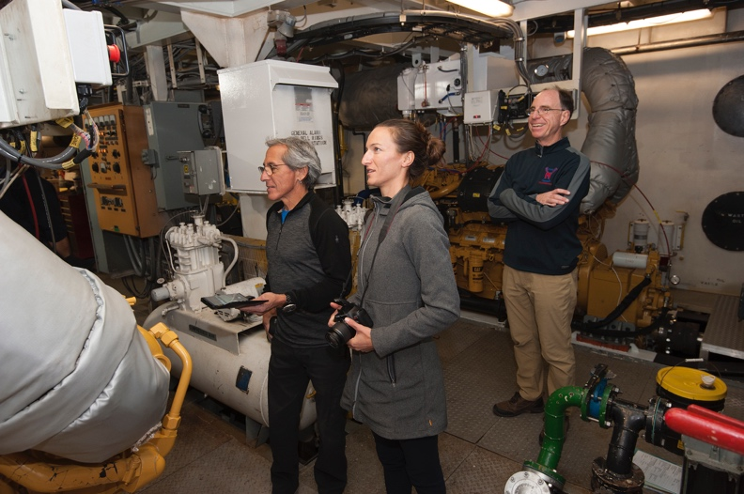

Slide 9
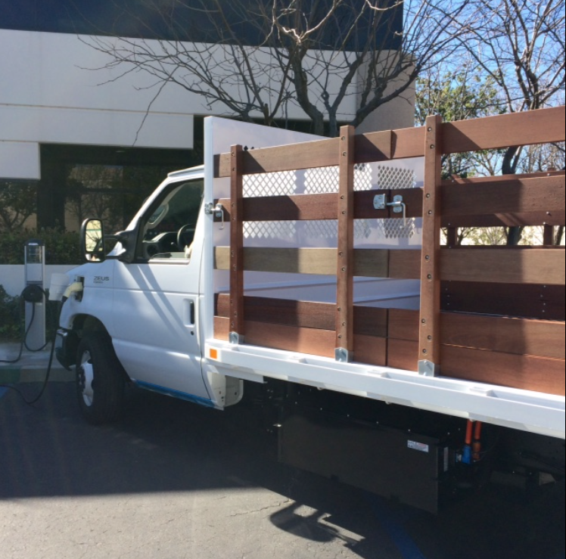
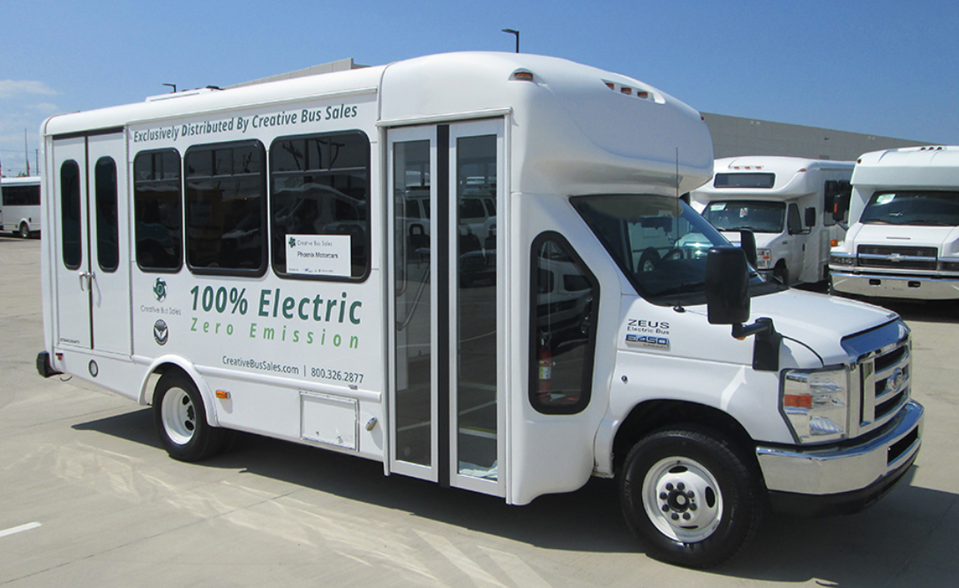
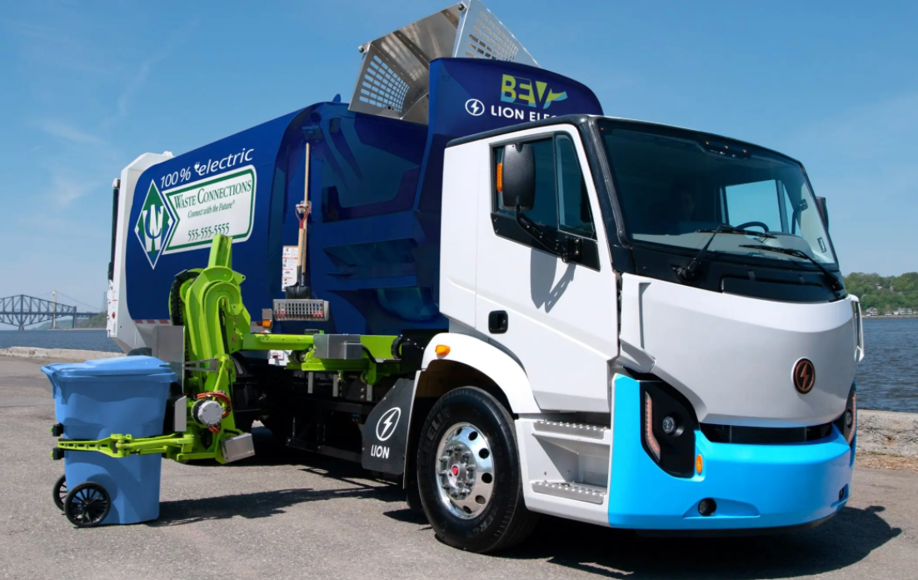
Notes:
On Road Example & Infrastructure

Slide 10
Eligibility (for all projects)
Project provides surplus emission reductions
Equipment to be replaced must be operational
Based in the District
75% of the use must be in California (mobile/portable)
At least 2 years documentation of usage (hours)
Legible serial numbers
Compliance with Air District/CARB Regulations

Slide 11
On-Road Electrification – Eligibility Criteria
GVWR must be greater than 14,000 lbs.
Existing Vehicles must be 2010 model year or older
Fleet Compliance with CA Truck & Bus Regs.
Existing trucks must be currently registered in Mo., Scz, or SB Counties
Must be in CAPP Priority Community
Max. funding per 2017 Moyer Guidelines
Notes:
Check guidelines

Slide 12
On-Road & Electrification Funding
Category | Project Type | Max Funding % | Max Funding $$
On-Road | Zero-Emission School Bus | N/A | $ 400,000
 | “” Transit Bus | N/A | $ 80,000
 | “” HHD Truck / Bus (GVWR > 33,000 lbs.) | N/A | $ 200,000
 | “” MHD Truck / Bus (GVWR 19,501- 33,000 lbs.) | N/A | $ 150,000
 | “” LHD Truck / Bus (GVWR 14,001- 19,500 lbs.) | N/A | $ 80,000
EV Infrastructure | All Projects | 50% | N/A
 | Publicly Accessible Projects | 60% | N/A
 | Projects with Solar/Wind Power Systems | 65% | N/A
 | Publicly Accessible Projects with Solar/Wind Power Systems | 75% | N/A
 | Public School Buses – Charging | 100% | N/A

Slide 13
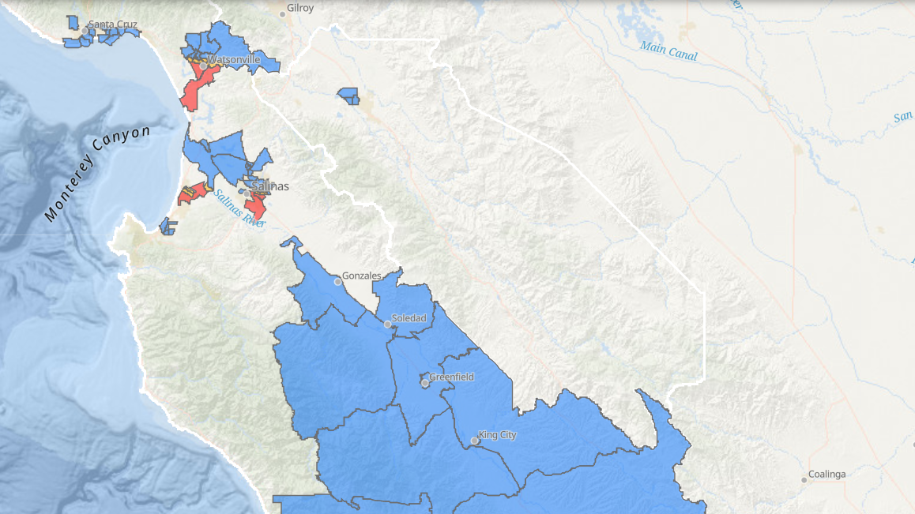
CAPP Priority Areas

Slide 14
On-Road Electrification Checklist
In compliance with State Fleet / Truck & Bus Regulations
Submit Copy of TRUCRS Fleet List
Submit Copy of Compliance Summary (TRUCRS)
Submit Copy of Compliance Certificate (TRUCRS)
Mileage records
Photographs of vehicles
Price Quote for replacement vehicle(s)
EV Charging infrastructure project scope

Slide 15
Irrigation Pump Electrification - Eligibility Criteria
Engine must be ≥ 25 horsepower
Must already be registered with the District
Maximum funding is 85 %

Slide 16
Irrigation Pump App Checklist
Photographs of the existing engine
Price quote for replacement equipment
Usage records

Slide 17
Marine Vessel - Eligibility
Operating hour meter
≥ 25 horsepower
2 years documentation of usage in California
Maximum funding of 50 % (up to $150,000)
Fishing and research vessels eligible for maximum
Submitted Initial Report per CHC Reg.
Repower completed 3 years prior to in-use compliance date

Slide 18
Marine Vessel Checklist
Attach existing engine verification
Attach photographs of the engine, hour meters
Attach price quote for replacement engine
Attach usage records (hour meter readings)
Attach copy of CHC Initial Report
Notes:
Engine verification:
US Coast Guard Documentation #
Valid CA Vessel Reg. (CF) Number
Copy of CA Fish and Wildlife license
Lloyd’s / International Maritime Organization (IMO) #

Slide 19
Off-Road Eq. Replacement Eligibility
≥ 25 horsepower
Baseline Engine must be Tier 0 - 3 rating
Equipment registered in DOORS (except agricultural)
Maximum funding is 50 % (up to $150,000)
Max. of 85% for Electrification Projects

Slide 20
Off-Road Eq. Replacement Checklist
Price quote for replacement equipment
Usage records
Copy of DOORS report (if applicable)

Slide 21
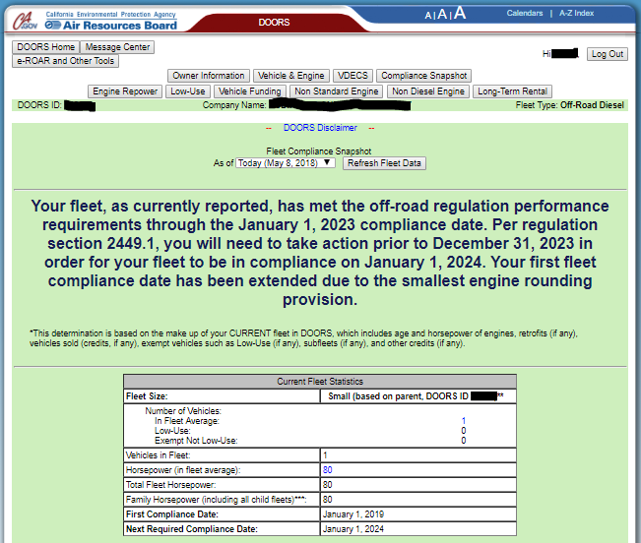
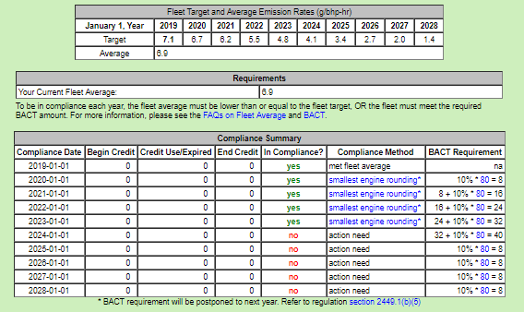
DOORS Snapshot Example

Slide 22
Application Requirements
Every field must be filled! – use “N/A” if doesn’t apply
Blank fields = returned application
Provide meter readings, earliest & most recent
If no records, start now and apply in two years

Slide 23
Application Requirements (cont.)
Max. of 2 contracts per Grantee at any time
More than one application may be submitted if there are numerous viable projects
Not accepted from grantees with 2 contracts
Not accepted from grantees failing to meet contract obligations

Slide 24
Project Evaluation
Determine project eligibility
Determine grant amount based on allowable cost effectiveness
Cost Effectiveness of $30,000/ton of emissions reduced
Rank projects based on CE per tons of emissions reductions ($/tons)

Slide 25
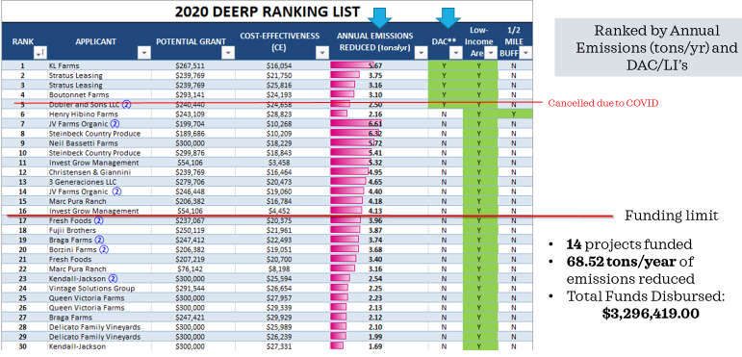
2020 Ranking by Annual Emissions

Slide 26
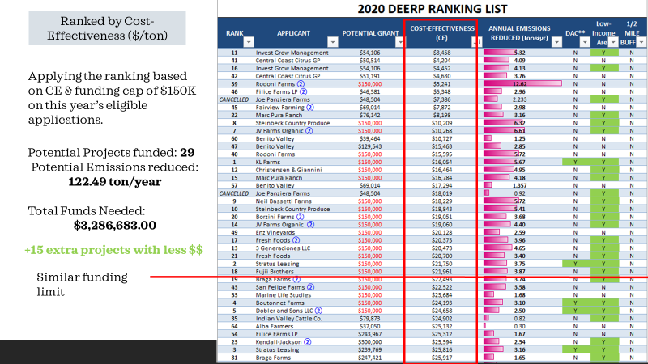
Compared to Cost-Effectiveness Ranking

Slide 27
Application Timeline
Applications accepted - January 13 to March 19, 2021
Ranking/selection - March to June 2021
Sign contracts - July to December/January 2021

Slide 28
APPLICATION DEMO

Slide 29
Resources
CARB CMP Guidelines:
http://www.arb.ca.gov/msprog/moyer/guidelines/current.htm
Commercial Harbor Craft Regulatory Activities:
http://www.arb.ca.gov/ports/marinevess/harborcraft.htm
Off-road diesel regulation:
http://www.arb.ca.gov/msprog/ordiesel/ordiesel.htm
MBARD Moyer:
http://mbuapcd.org/programs-resources/planning/grants-incentives/carl-moyer-program/
FARMER Program
https://ww2.arb.ca.gov/our-work/programs/farmer-program

Slide 30
Contact
Off-Road & Marine Replacements
Hanna Muegge, Air Quality Planner
831-718-8021
hmuegge@mbard.org
On-Road Electrification
Alan Romero, Air Quality Planner
831-718-8030
aromero@mbard.org

