Slide 1

Monterey Bay Air Resources District
Diesel Engine & Equipment Replacement
Grant Program
Public Workshop Presentation
October 2, 2024
Tyrone Bell, Air Quality Planner
Irene Miranda, Air Quality Planner

Slide 2
Workshop Purpose/Outline
Purpose
Increase chances of a project’s success by encouraging the completion of thorough and accurate applications.
Outline
Introduction
Funding Sources
Project Types
Project Eligibility
Project Evaluations & Ranking Process
Application Tips
Demonstration
Notes:
TY

Slide 3
What is the Diesel Engine & Equipment Replacement Program?
“Provides grant funding to encourage the voluntary purchase of cleaner-than-required engines, equipment, and emission reductions technologies.”
- Carl Moyer Program Guidelines
Complements regulations to obtain early or
“surplus” emissions reductions
(not otherwise achieved through regulations)
Notes:
TY

Slide 4
Funding Sources
Carl Moyer Memorial Grant Program (Moyer or CMP)
Funding Agricultural Replacement Measures for Emission Reductions Program (FARMER)
  ~$2.4 Million allocated (combined)
Community Air Protection Program (CAPP)
  Focus is to reduce exposure in communities most impacted by air pollution
  Eligible projects funded as funding becomes available
  Incentives up to 90% or $200,000 of replacement costs, whichever is less
Notes:
TY

Slide 5
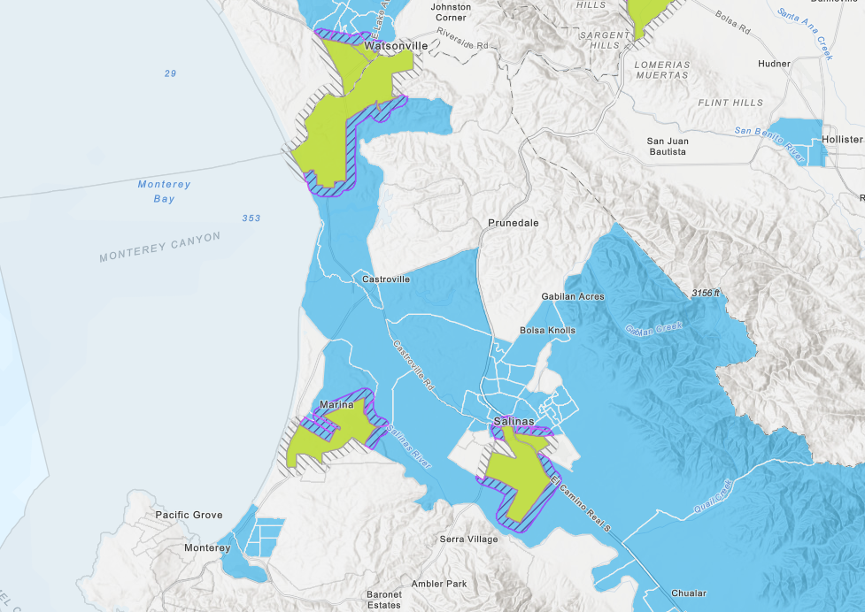
CAPP Priority Areas
California Climate Investments Priority Populations 2024
Notes:
TY

Slide 6
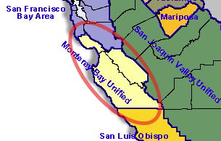
Project Types
Agricultural Irrigation Pumps
Marine Vessels
Mobile Off-Road Equipment
Upcoming early next year:
  Agricultural Utility Terrain Vehicle (UTV)
Notes:
IRENE: The CMP is statewide, so it offers various types of projects. Each Air District in CA adopts program types that benefit its region’s unique needs. MBARD includes the Counties of Monterey SC & SB. Since our region has important agricultural and marine industries, these are the types of projects MBARD focuses on.
Off-Road Equipment Mobile Equipment includes agricultural tractors, as well as off road construction equipment like bulldozers forklifts and trash compactors.
There’s a new program being developed to replace < 25 hp diesel equipment for Ag UTVs. MBARD will likely announce it early next year. Get on the DEERP mailing list for updates, see web links at the sign-in table.

Slide 7
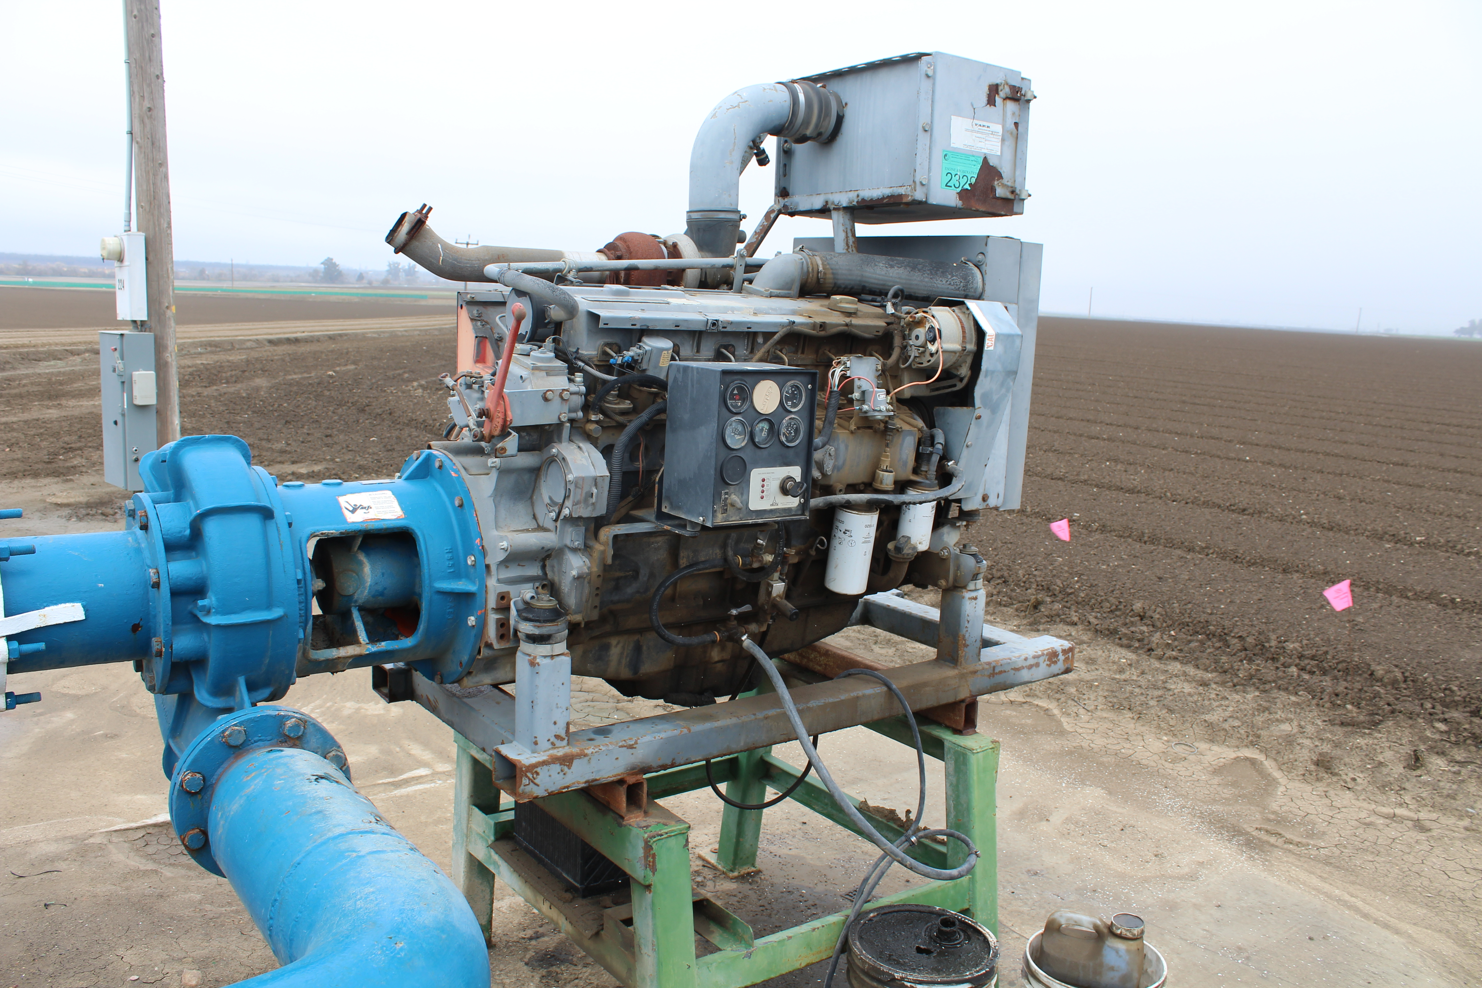
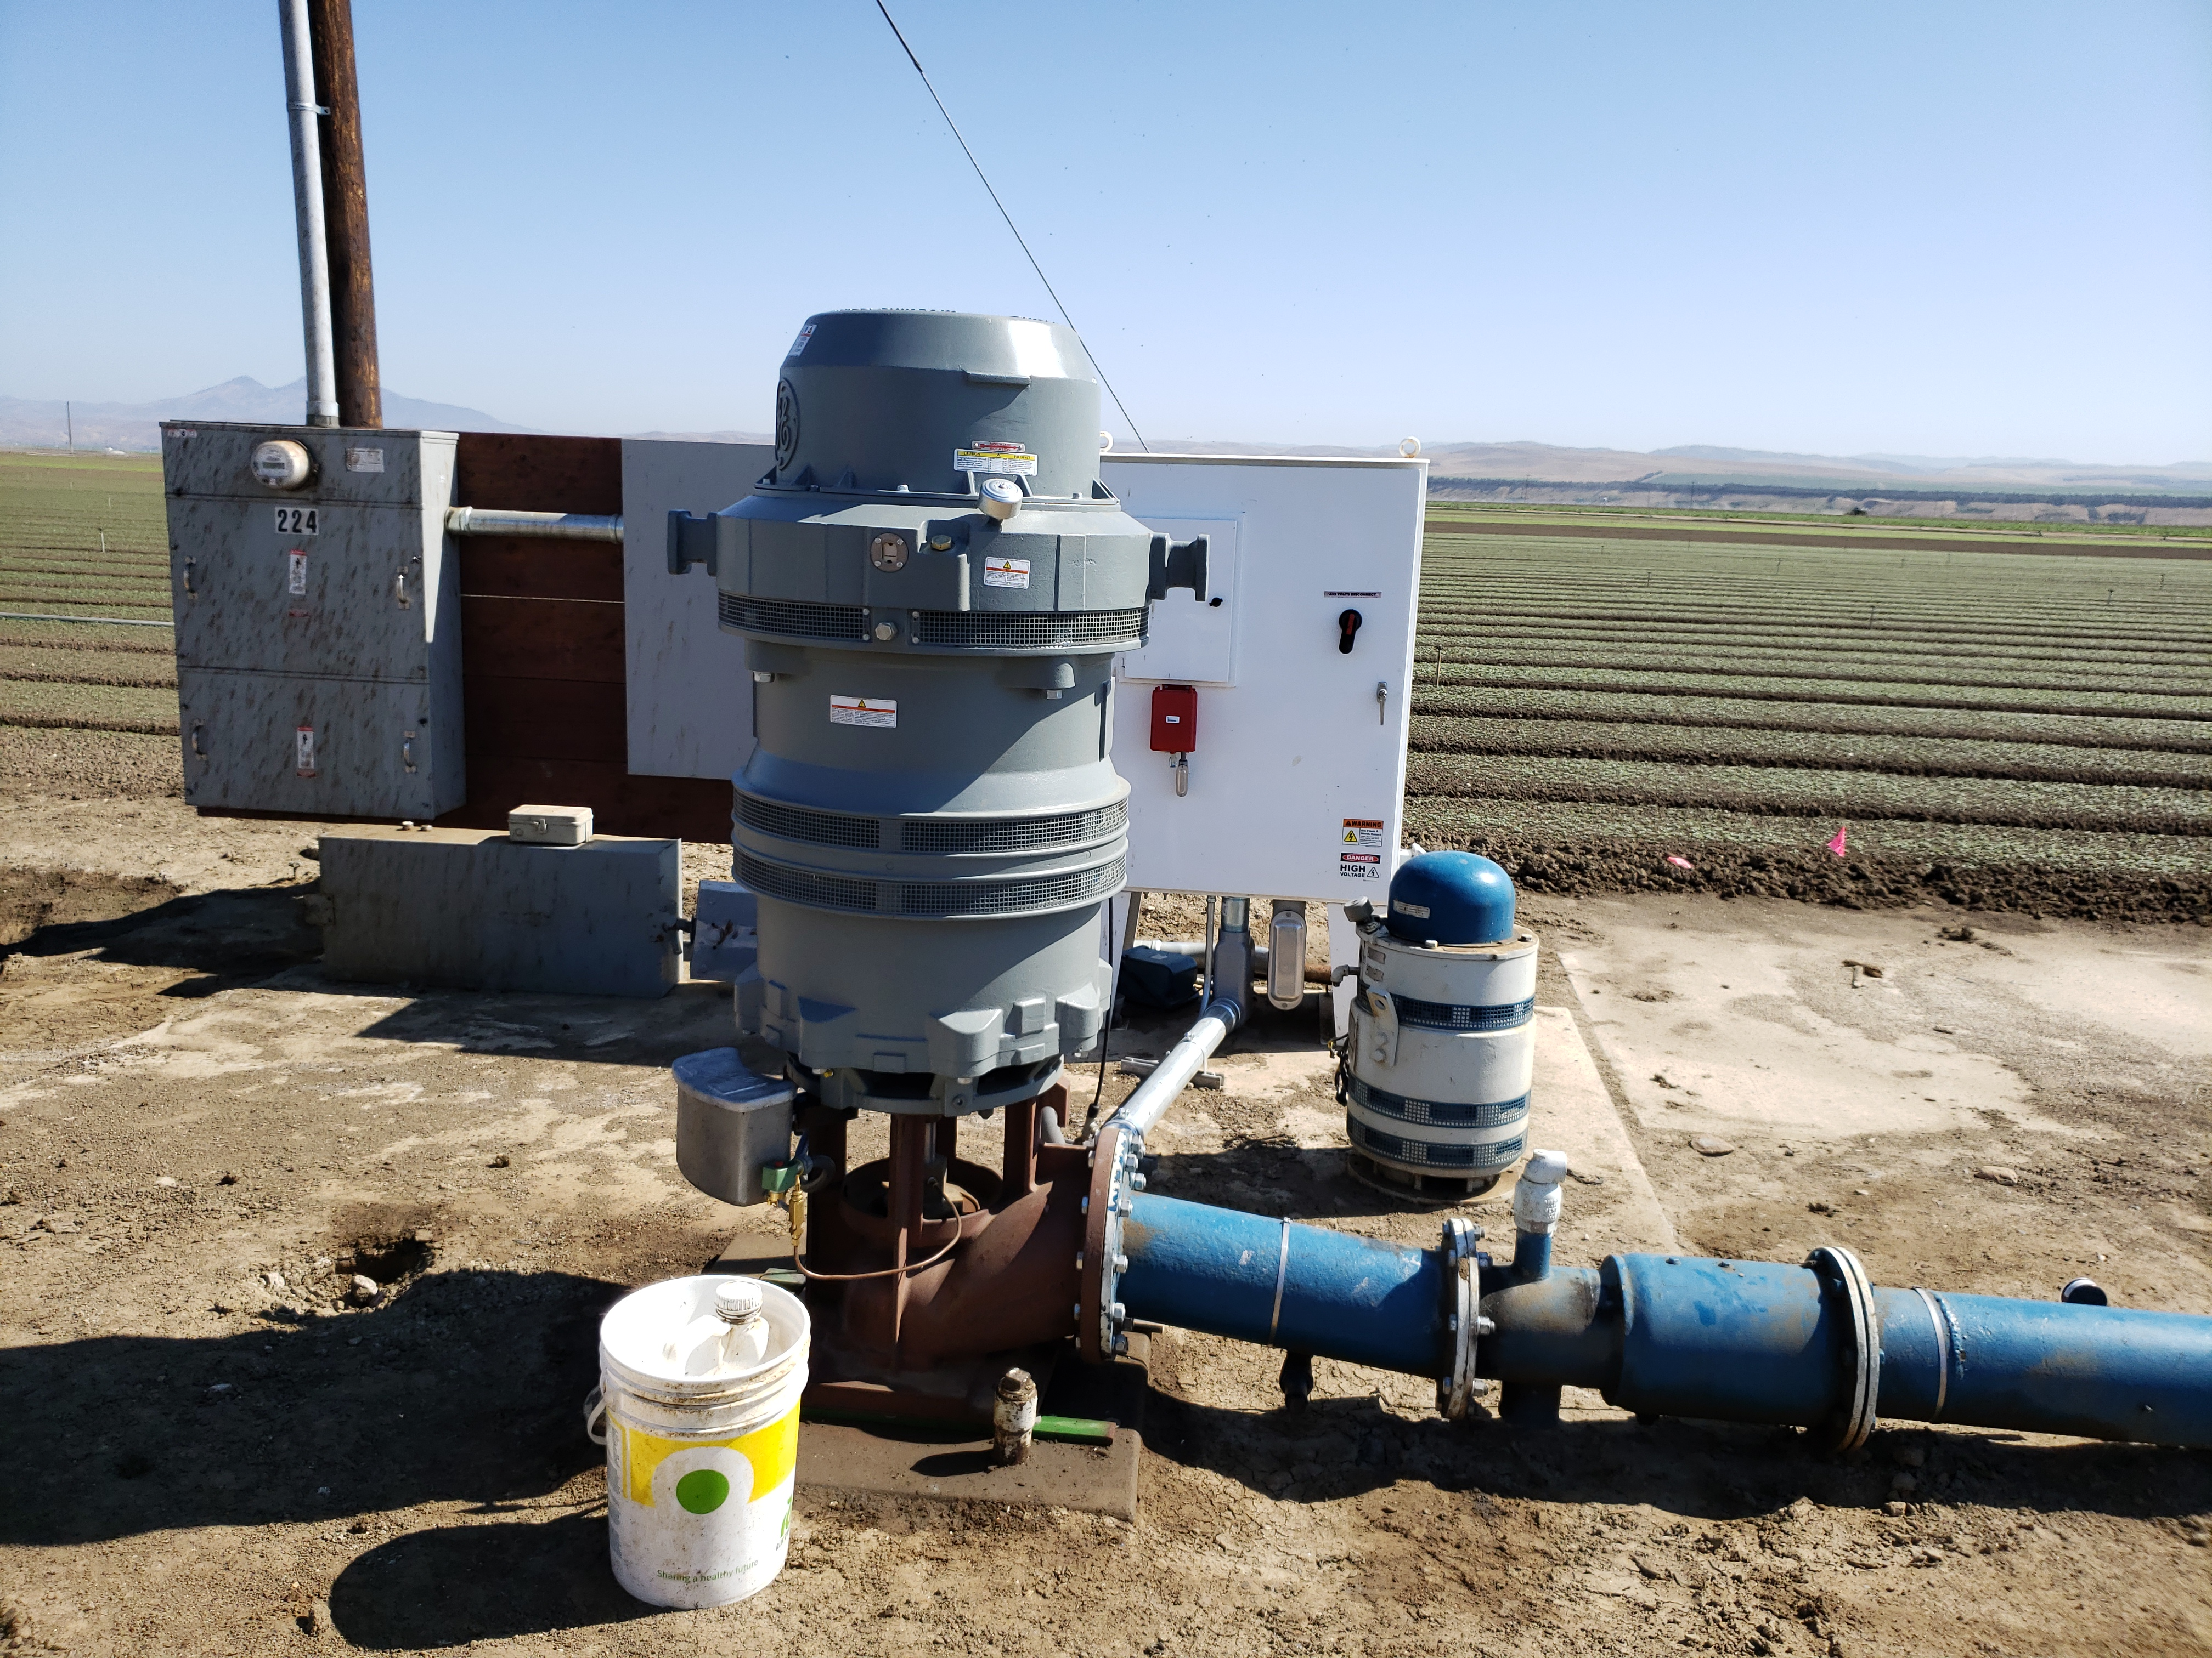
Irrigation Pumps
Irrigation Pumps
Notes:
IRENE: At top left is a diesel irrigation pump that was replaced with a zero emission electric motor. These projects bring a lot of emission reduction at low cost, so California is strongly encouraging electrification projects. In fact, any eligible zero-emission project gets top priority. Just keep in mind these projects can take time because they can be dependent on PG&E.

Slide 8
Eligibility: Irrigation Pump Electrification
Engine must be ≥ 25 horsepower
Engine must be registered with MBARD
  Not Registered? Contact MBARD Engineering (831) 718-8018
Max Incentive = 85% of new pump
Notes:
IRENE: These projects are evaluated on a case by case basis, so please contact us with questions.

Slide 9
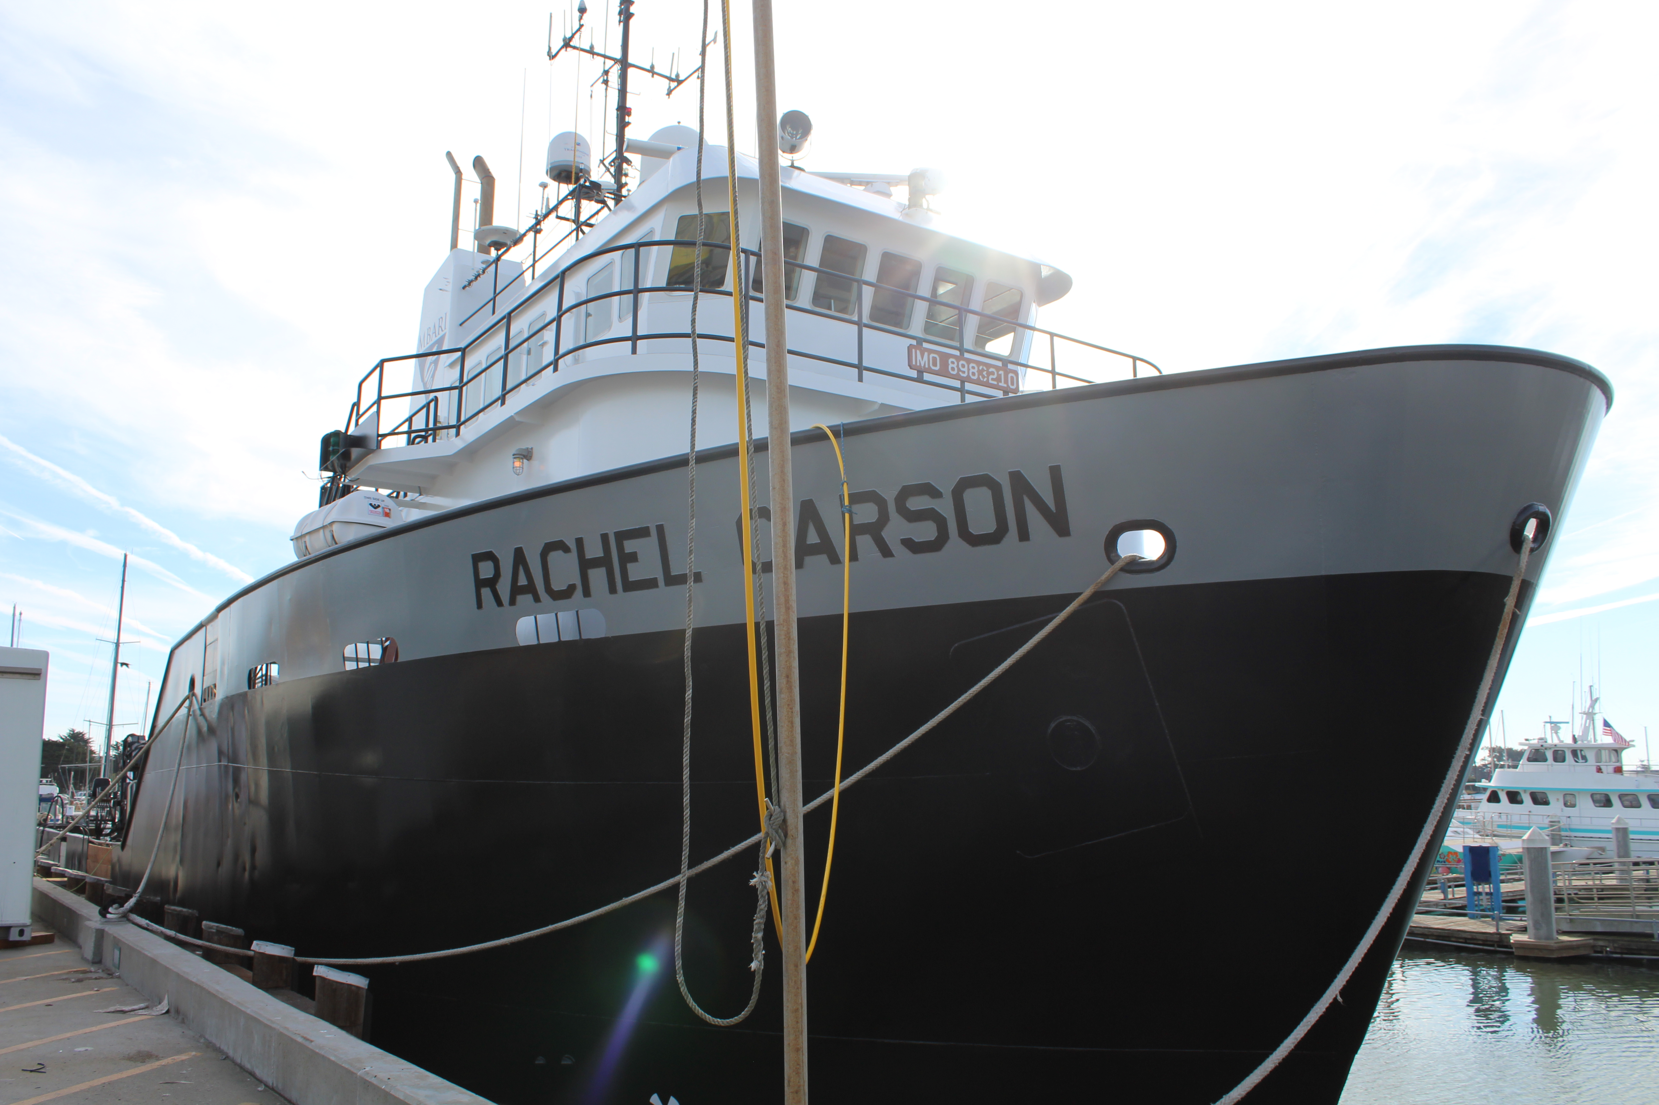
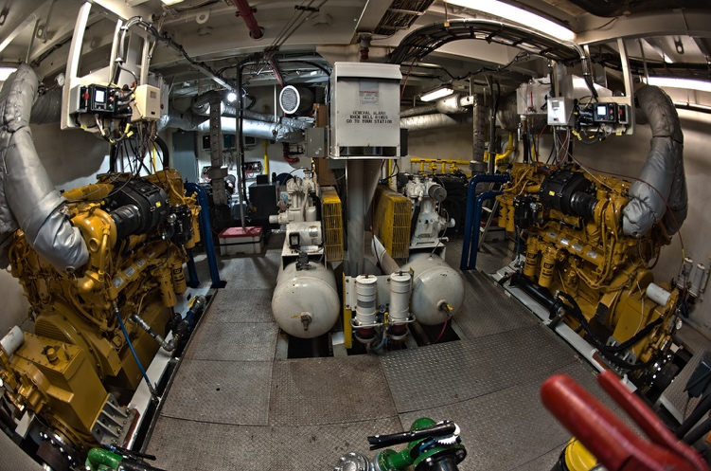
Marine Vessels
Notes:
IRENE: for marine vessel projects, this program will replace the engines. This vessel is the Rachel Carson, owned by MBARI, the Monterey Bay Aquarium Research Institute, docked in Moss Landing. In 2017 the two main diesel engines were replaced with two electric 750 hp Challengers. This project saves about 8.4 tons of pollution emissions each year. Smoke no longer pours out of the stacks.

Slide 10
Eligibility: Marine Vessel
Operating hour meter
≥ 25 horsepower
2 years documented usage in California
Compliance with Commercial Harbor Craft Regulations
Incentive funds cover 50% - 85% of replacement cost
Notes:
IRENE: The Commercial Harbor Craft regulations have been updated in the past year, so contact us about requirements.

Slide 11
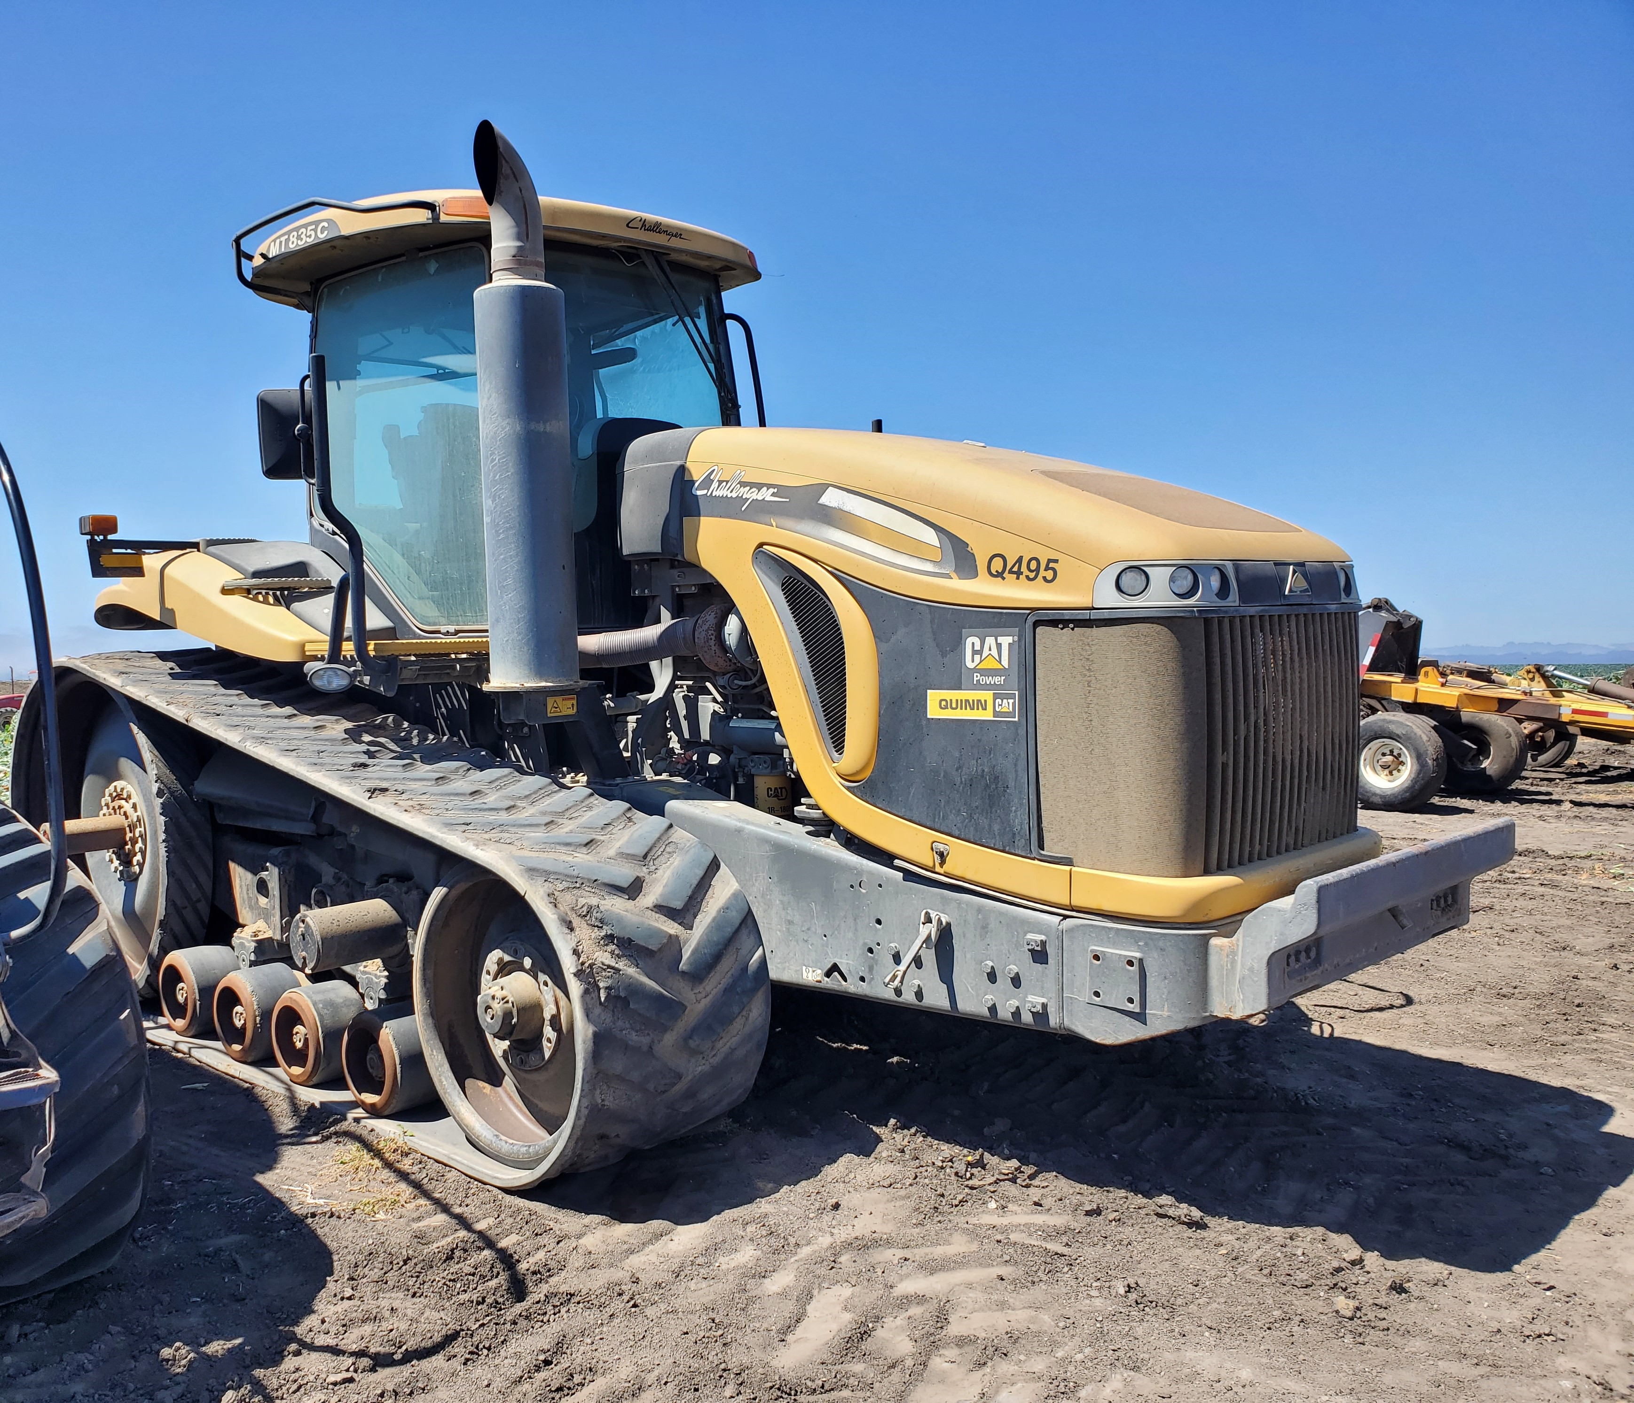
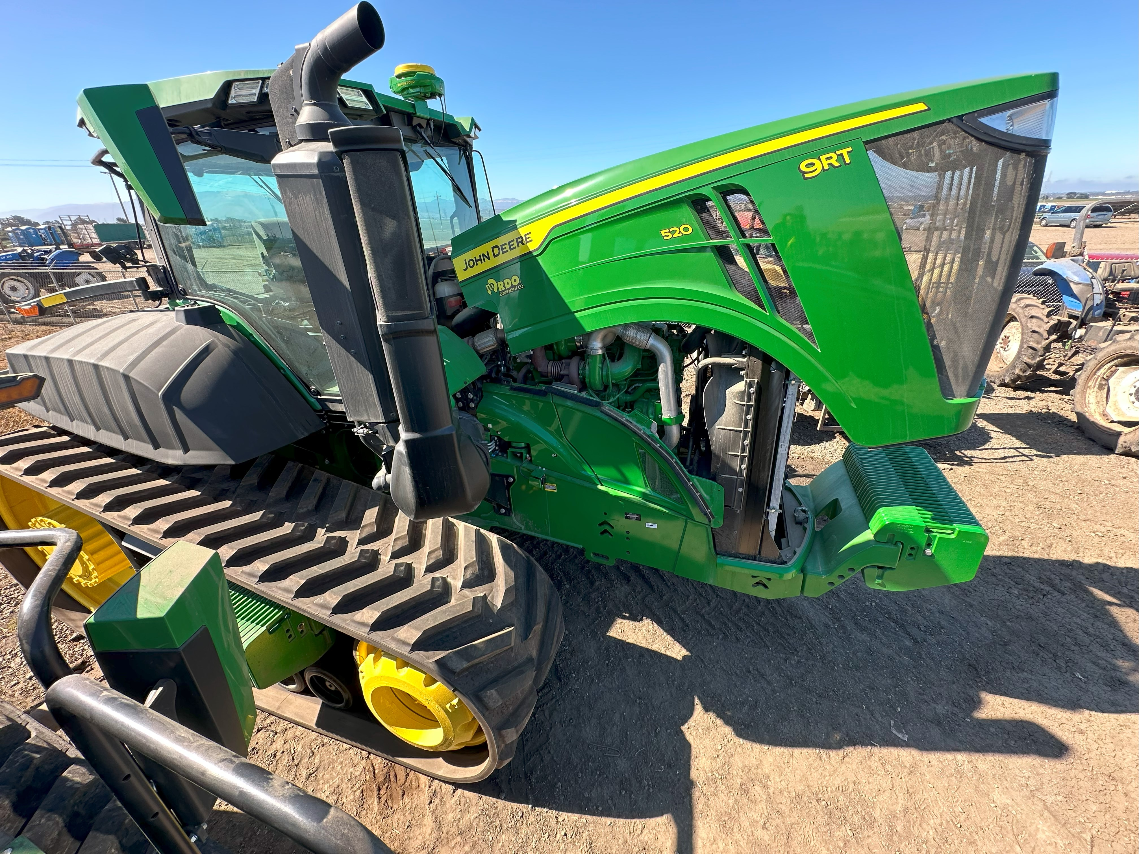
Mobile Off-Road
Notes:
IRENE: Row crop and crawler tractors are the typical projects for off road mobile replacement. This Cat crawler was recently replaced with a 520 hp 9RT. We often hear that grant funds allow an upgrade to the largest hp tractor on the farm, creating an opportunity to use larger more efficient implements.

Slide 12
Eligibility: Off-Road Equipment Replacement
≥ 25 horsepower
Equipment registered in DOORS (except agricultural)
Maximum funding is 50% (up to $150,000)
  Max. of 85% for Electrification Projects
Notes:
TY

Slide 13
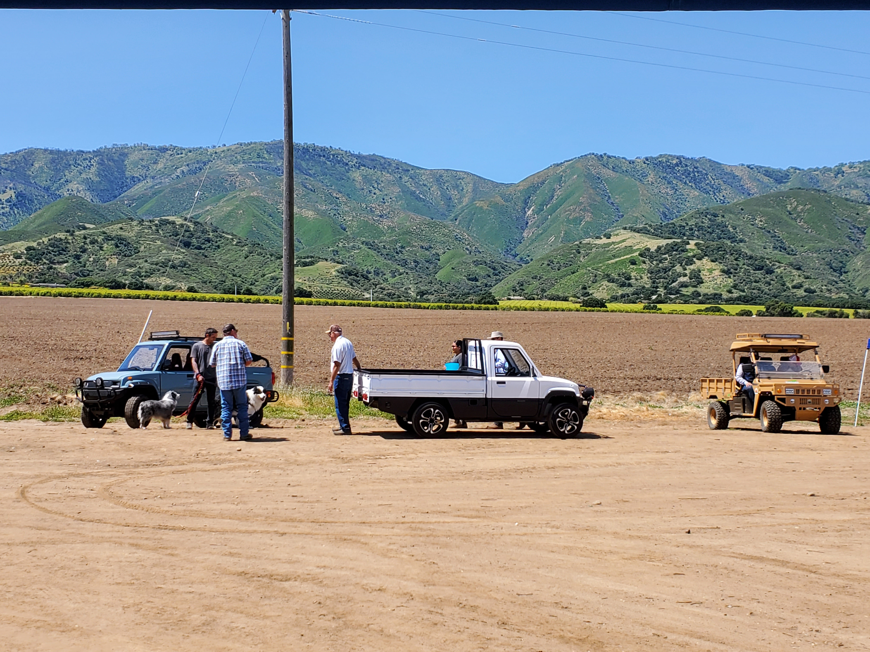
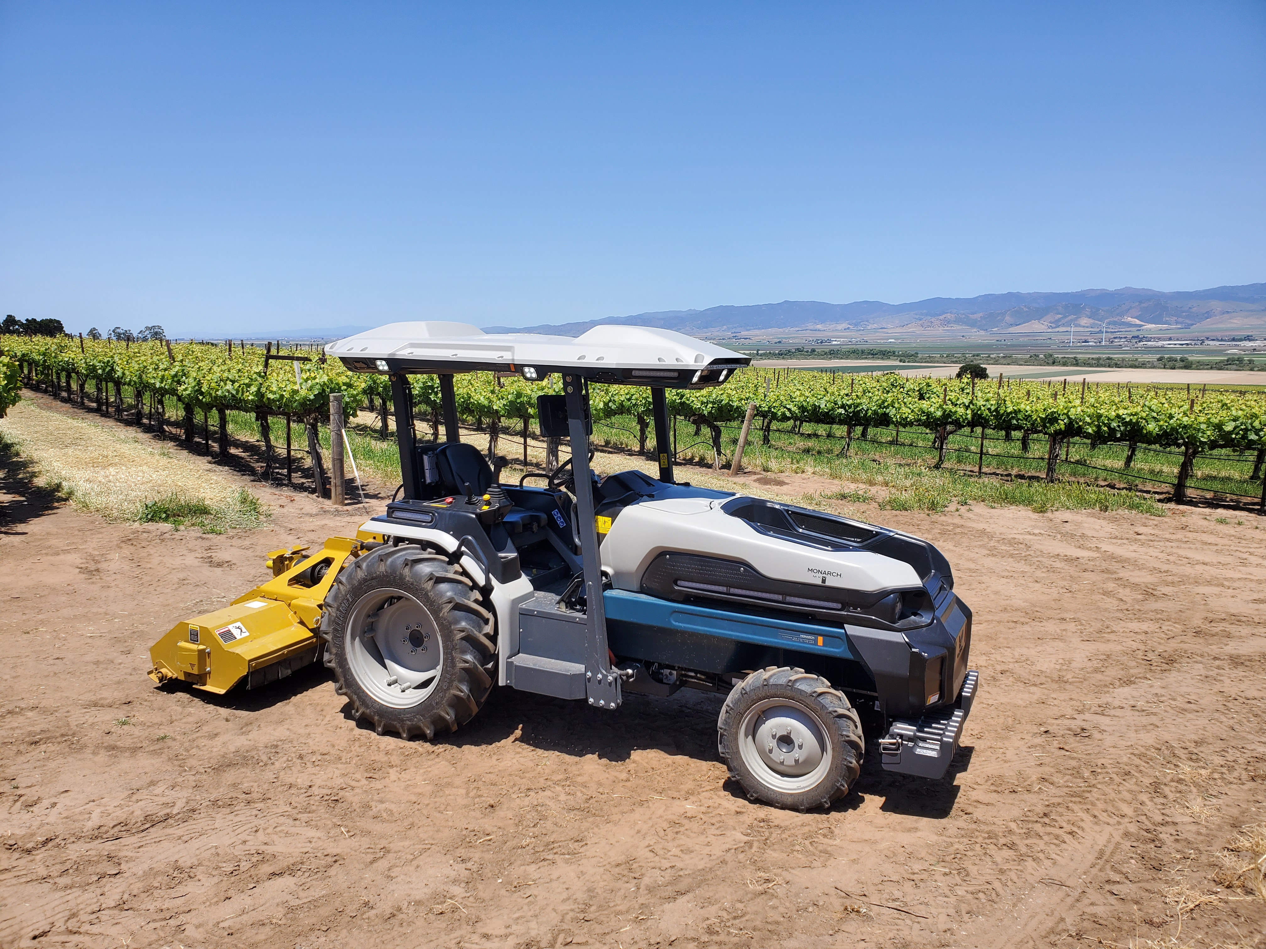
Upcoming: Agricultural Utility Terrain Vehicle
Baseline (vehicle or equipment) = UTV or Tractor < 25 hp
Baseline must be permanently destroyed
Replace with a new Zero-Emission UTV
For agricultural use only
Notes:
IRENE:

Slide 14
Eligibility Criteria: All Project Categories
Project must provide surplus emission reductions
In compliance and in good standing with CARB and MBARD regulations
Baseline equipment (to be replaced) must be operational
Operation based within District
  75% of use must be in CA (of mobile/portable equipment)
Taken NO ACTION to procure, order, take delivery of, or purchase replacement equipment until a grant offer has been made and the contract has been fully executed
Only two active contracts per Grantee at any time
  Potential Case-by-Case Exceptions:
    CAPP eligible zero-emission projects
    Replacing contracts within 6 months of expiration
    Electrification projects – contact MBARD!
Notes:
TY

Slide 15
Eligibility Criteria: All Project Categories
Required Documentation:
  Ownership – owned in CA for the previous 2 years
  Usage – most recent 2 years of usage records (in hours)
  Operation – equipment was operational in previous year
  DOORS Snapshot – only required for non-agricultural projects
LEGIBLE maintenance or service records/logs, repair or work orders, registration, bill of sale, employee timesheets, inspections, etc.
Itemized Quote
NOTE! At least 200 hours must have been accrued
in the 12 months prior to your application date
Notes:
TY

Slide 16
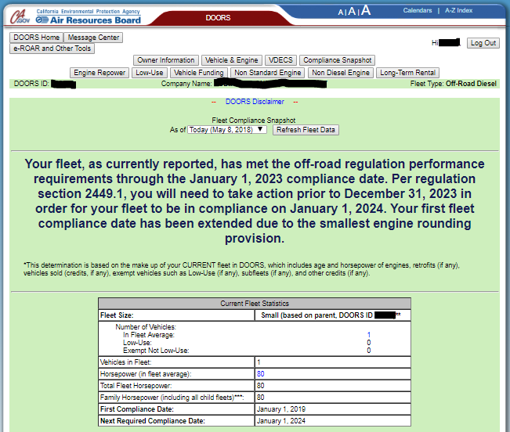
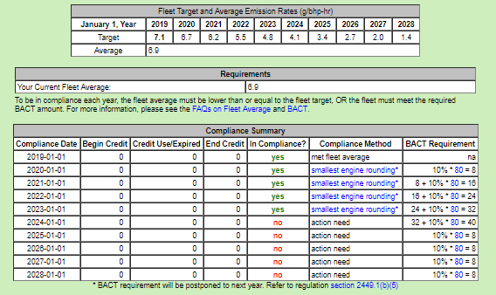
DOORS Snapshot Example
REQUIRED FOR NON-AG ONLY
Notes:
TY

Slide 17
Upcoming: Agricultural Utility Terrain Vehicle
Baseline (vehicle or equipment) = UTV or Tractor with less than 25 hp
  Owned and operated baseline in CA for the previous 2+ years
  Engine model year must be 5+ yrs older than application year
Replacement Zero-Emission UTV must be:
  New – never sold or registered (CA Vehicle Code §430)
  Towing capacity of 500+ lbs.
  Total vehicle weight of 700+ lbs.
  Minimum 1 year warranty covering the drivetrain, including applicable energy storage tanks or battery packs
Replacement Incentive – baseline must be permanently destroyed
Notes:
TY

Slide 18
Upcoming: Agricultural Utility Terrain Vehicle
Off-Road Utility Terrain Vehicle (UTV) = Any off-highway motor vehicle that has all the following features and characteristics:
  designed to travel on four or more wheels
  bench or bucket seating for 2+ persons
  steering wheel for steering control
  designed for operation over rough terrain
  internal combustion engine with a displacement ≤ 1 liter
  maximum brake power ≤ 30 kW
  capable of speeds 25+ mph
  either 1) a rear payload of 350+ lbs., or 2) seating for 6+ passengers
Notes:
TY

Slide 19
Project Evaluation & Ranking Process
Check eligibility
Rank projects
Ranking priorities:
  Electrification
  Priority Populations
  Cost Effectiveness ($ per ton of emissions reduced)
    Age of baseline equipment
    Hours used per year
    Cost of new equipment
Notes:
IRENE: After you submit your application, this is what happens
We make sure applications are complete and the project is eligible. Then we rank all the projects.
There are 2 types of projects that automatically go to the top of the list. The first type are electrification projects because they produce zero emissions,. The second type are projects located in the State’s designated “priority population” areas (this is also known as the Community Air Protection Program or CAPP). Ty discussed this earlier.
Then we rank all the projects according to cost effectiveness. The idea is to pay less $ per ton of emissions reduced and depends on the age of the baseline equipment (older is more competitive), number of hours used (high usage is more competitive), and cost of new equipment (lower cost is more competitive). In practice that means 1992 Tier 0 tractor used 2000 hrs/yr will likely rank higher and be funded before a 2008 Tier 3 tractor used 500 hrs/yr.

Slide 20
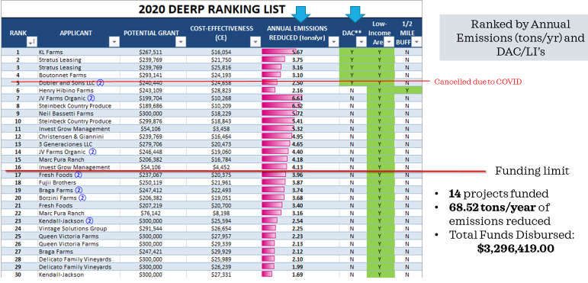
2020 Ranking by Annual Emissions
Notes:
IRENE: Here’s what the 2020 ranking list looked like. See the top 4 rows above the first red line – those were all high priority projects located within the Priority Population areas.
Below that were projects ranked by Cost Effectiveness – see the pink bars. Longer bars are more cost effective and will get funded first.
The lower red line marked the limit of funds so the projects below that line were not likely to get funded.
For this year, the ranking list will be published on MBARD’s website

Slide 21
Timeline
Applications accepted October 2 – December 16
Projects Ranked: December 16 – 1st Quarter 2025
Grant agreements offered: 1st and 2nd Quarter 2025
Notes:
IRENE: the application period just began. The application form is now available on MBARD’s website. The application period will close December 16. Do yourself a favor and start the process now. You can save drafts of the application as you go along. Then when you’re sure its complete and accurate, you can submit it – no later than December 16.
We will be processing applications as they come in, but the ranking must wait until after the application period closes so we can consider all eligible applications. The ranking list will then be published on MBARD’s website in the 1st Quarter of 2025, so sometime before the end of March. Then our Planning team members will start contacting you to begin projects, with the highest-ranking applications first.

Slide 22
Application Tips
COMPLETE ALL REQUIRED FIELDS (*)
Ownership, usage, and operationality documents
Photos of baseline engines and equipment
2 applications per EIN or tax ID
2-for-1 replacements are eligible
You can save drafts
You do not need to be first – applications are ranked
Max file size = 25 MB
Notes:
TY

Slide 23
DEMONSTRATION:
LASERFICHE
ONLINE APPLICATION
Notes:
MICHAEL

Slide 24

Question & Answer
Application: MBARD.org / Grants / Diesel
Engine & Equipment Replacement
Program
Resources on DEERP webpage:
CARB Program Guidelines
Compliance Assistance for Off-Road Diesel Regulation (non-ag construction equipment)
Commercial Harbor Craft Regulations
MBARD DEERP mailing list link
Map tool for CAPP Priority Population projects
CARB Executive Order website (for Engine Family)
Pick up handout at sign-in table for web links
Tyrone Bell: 831-718-8023, tbell@mbard.org
Irene Miranda: 831-718-8021, imiranda@mbard.org
Notes:
IRENE

